Slide 1
AI BASED FIRE EXTINGUISHING ROBOT
GROUP GUIDE-PROF SACHIN TAKMARE
GROUP MEMBERS-
SWAPNIL VERNEKAR
SUMAN SHREYAS
RISHABH JHA
SANDHYARANI THATIPAMULA

Slide 2
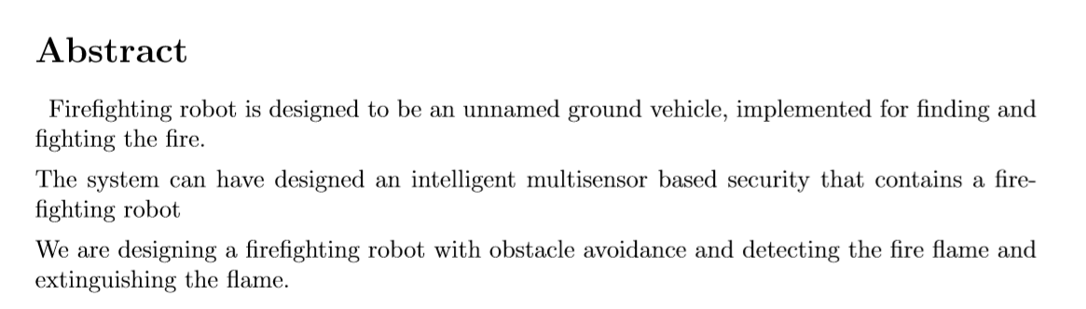

Slide 3
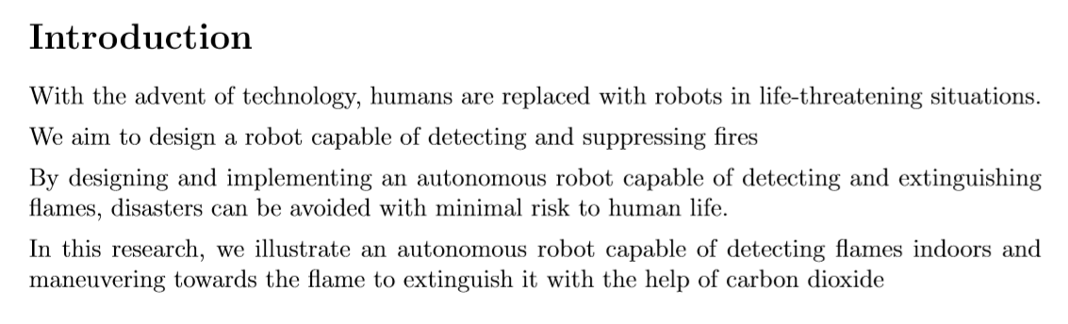

Slide 4
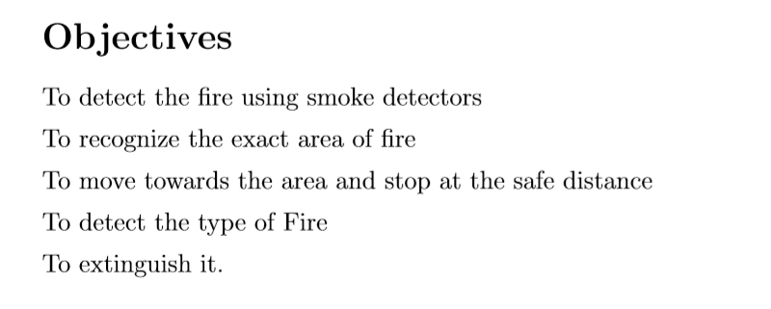

Slide 5
LITERATURE REVIEW
The idea of AI based fire fighting robot was emerged as there is no robot that is capable of tracking and extinguishing the fire autonomously in a particular area or region.
Our project will be successful with the help of number of sensors that will be used in the robot for sensing the environment.
We have researched a number of research papers for our project and got a lot of knowledge of the same.
RESEARCH PAPERS-
1-(IJARCCE Fire Fighting Robot Research paper)-We got the basic idea of the sensors and the hardware used.
2-(Rochester Institute of Technology)-Got the idea of the basic structure of the robotic car and the behaviour of the number of sensors in the fire environment.
3-(Fire Locator,Detector and Extinguisher)-How to connect the various sensors to the hardware of the car.

Slide 6
Problem Definition
This project is all about Fire Extinguishing Robot which has AI built into it.It has an ability to trigger itself accordingly when it senses fire around it.
The robot is completely autonomous which works on the sensors and using the fire servers which is connected to the fire sensors.
It will be designed to efficiently extinguish the fire in no time .

Slide 7
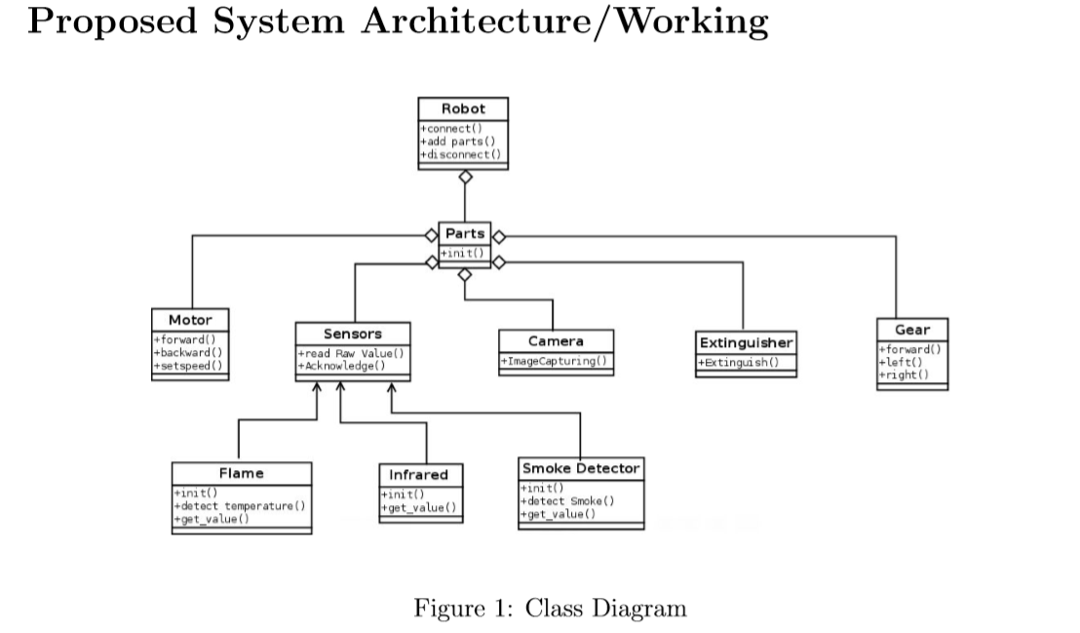

Slide 8
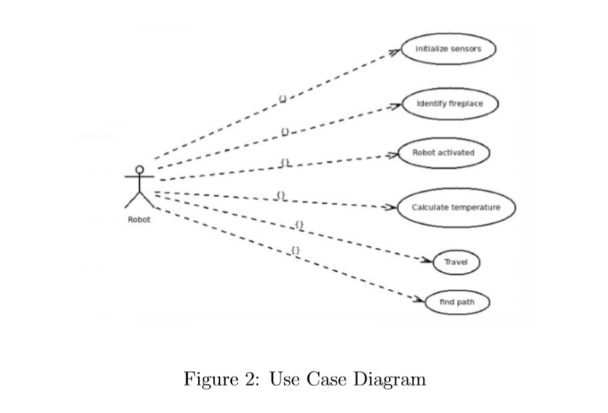

Slide 9
